Slide 1
Team 3 Final Presentation
CS691 – Fall Semester 2021

Slide 2
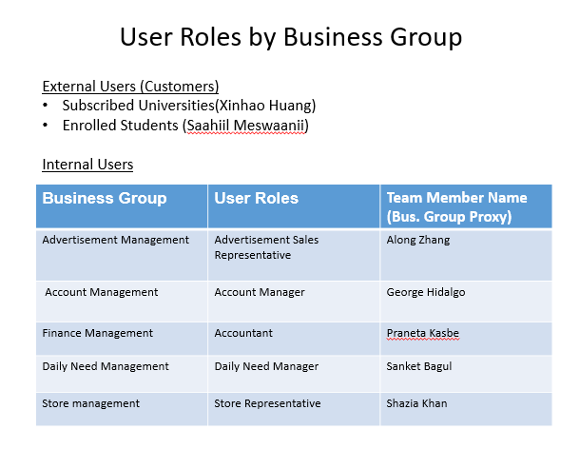
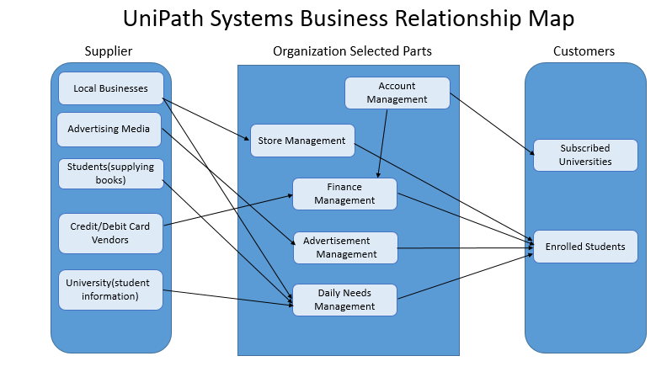
BRM Diagram and UserRoles - Shazia
https://docs.google.com/presentation/d/1vmIbaPiej2Ep-p8o7Jaro8p3jzmqmMnP/edit?usp=sharing&ouid=101575546030556260281&rtpof=true&sd=true

Slide 3
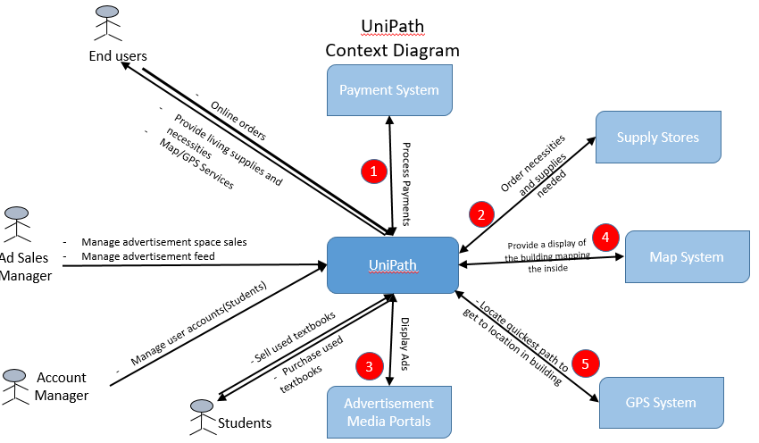
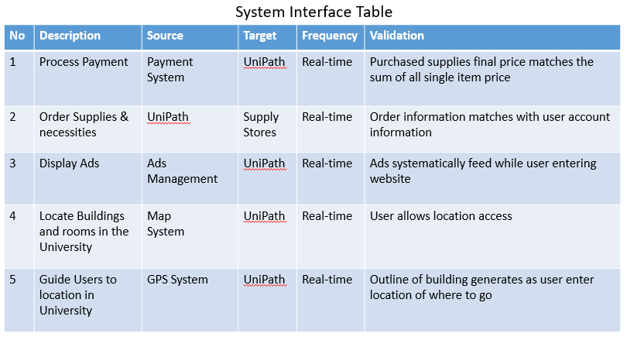
Context Diagram and System Interface Table - George
https://docs.google.com/presentation/d/1bz5MaSk-mrPfAQjd1eWaLGuLP6-LTTX8/edit?usp=sharing&ouid=101575546030556260281&rtpof=true&sd=true

Slide 4
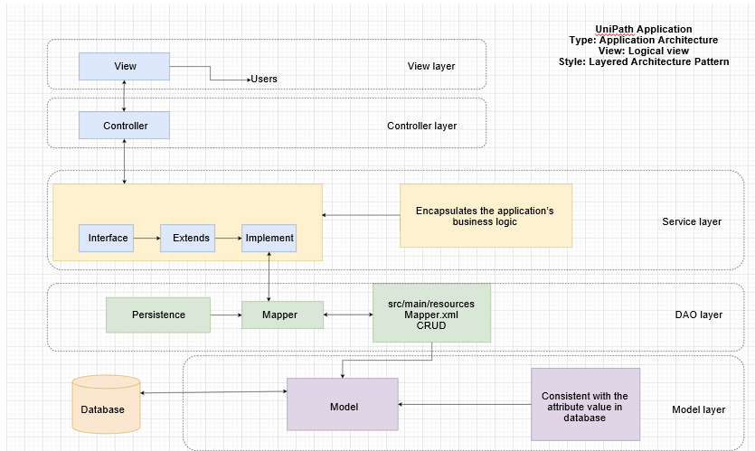
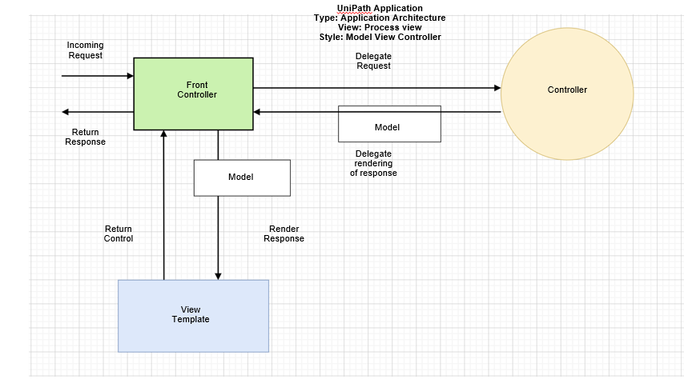
Architecture Design Logical & Process - George
https://docs.google.com/presentation/d/1_7fIkeah25E37eSJslHRCq0E-vsBO5tF/edit?usp=sharing&ouid=101575546030556260281&rtpof=true&sd=true

Slide 5
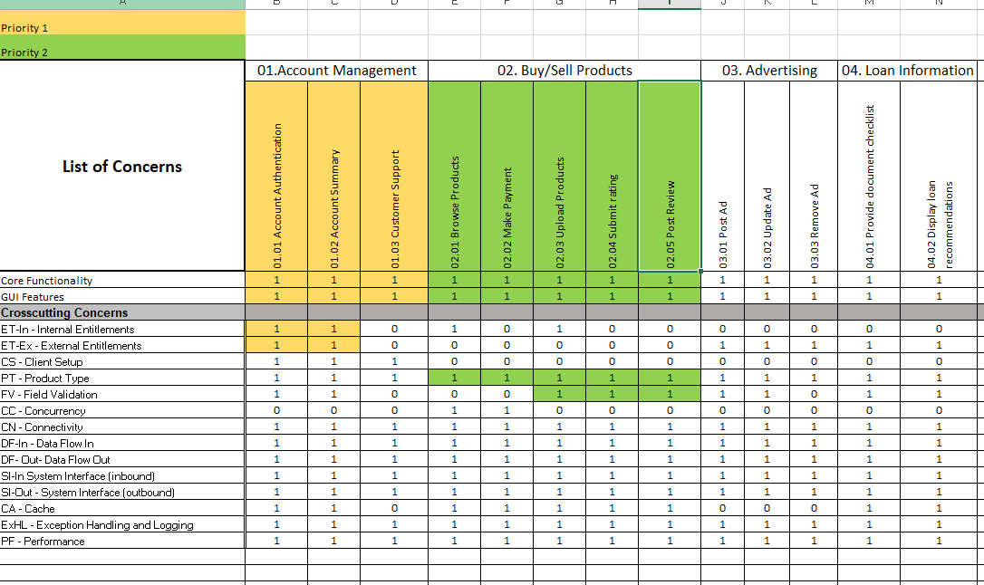
Requirements Composition Table - Praneta
https://docs.google.com/spreadsheets/d/1zpkkUHGKy6BvEUf9fr6ylpNbMeZ4OQoE/edit?usp=sharing&ouid=101575546030556260281&rtpof=true&sd=true

Slide 6
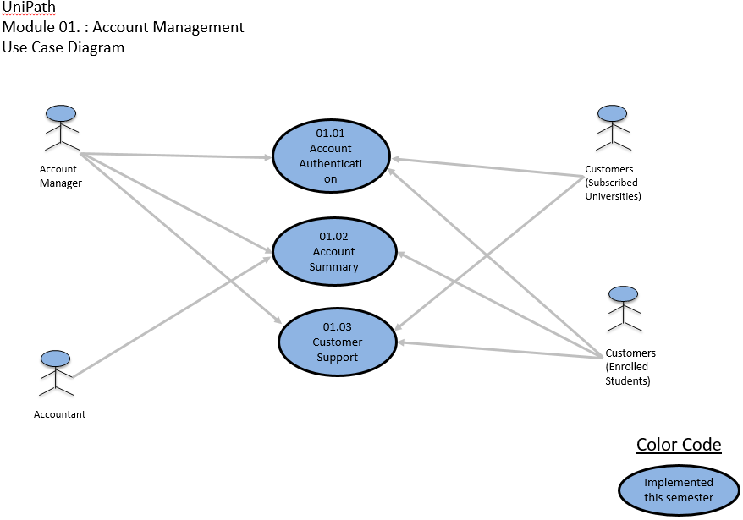
Use Case Diagram - Praneta
https://docs.google.com/presentation/d/1URyAQ6JHSqf2hi9_57LUfHK15yPLSJEe/edit?usp=sharing&ouid=101575546030556260281&rtpof=true&sd=true

Slide 7
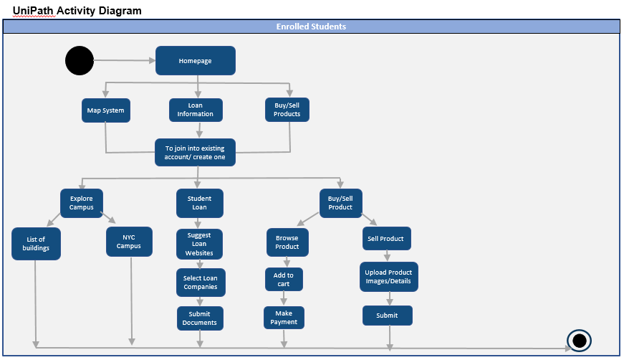
Activity Diagram - Praneta
https://docs.google.com/presentation/d/14JmPAsmyXqx2Dw7pCgQ7rslScGCwkUK5/edit?usp=sharing&ouid=101575546030556260281&rtpof=true&sd=true

Slide 8
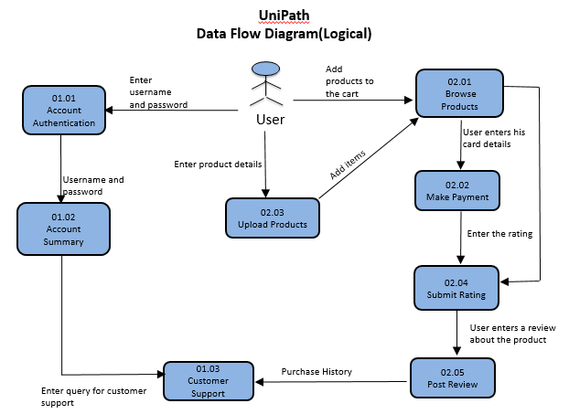
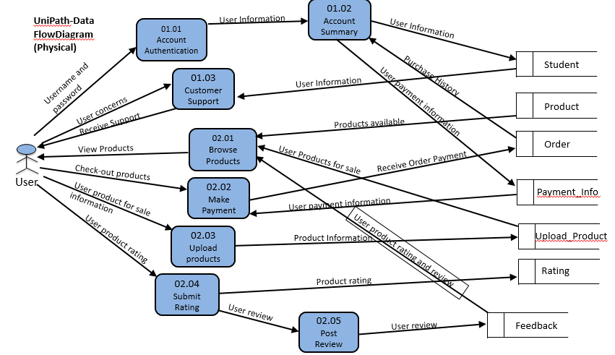
Data-Flow Diagram Logical, Physical - Saahiil
https://docs.google.com/presentation/d/193v_T45HOL6kItc8CQa2aauulqSLvLxJ/edit?usp=sharing&ouid=101575546030556260281&rtpof=true&sd=true

Slide 9
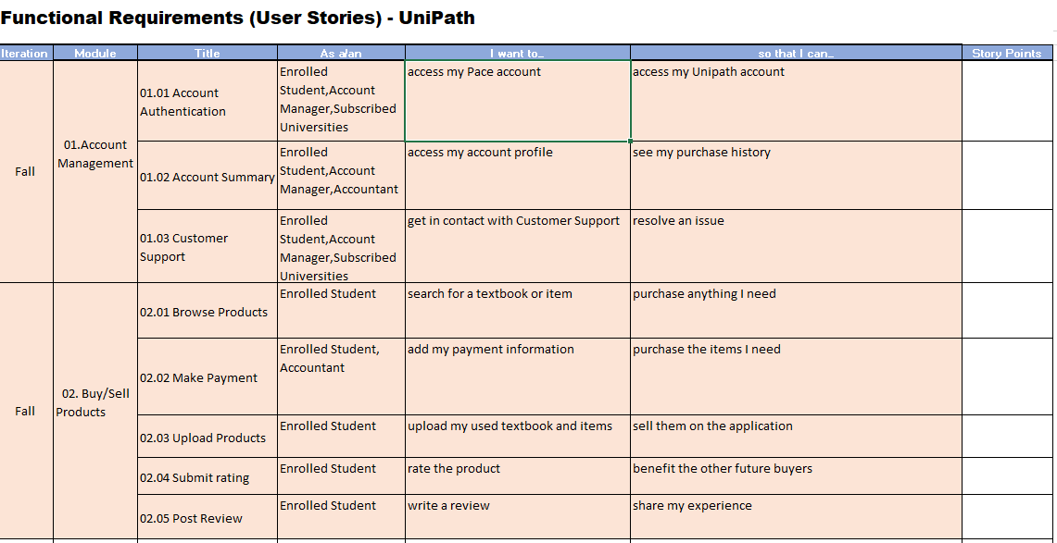
Functional Requirements/ User Stories - Saahiil
https://docs.google.com/spreadsheets/d/1vFn6dZb9bbSoXTdWc6YojP7V5cs-J5vJ/edit?usp=sharing&ouid=101575546030556260281&rtpof=true&sd=true

Slide 10
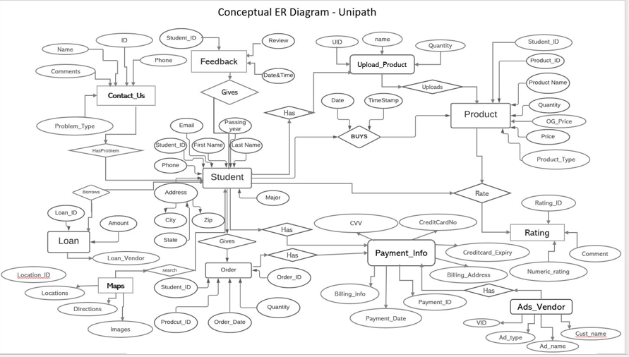
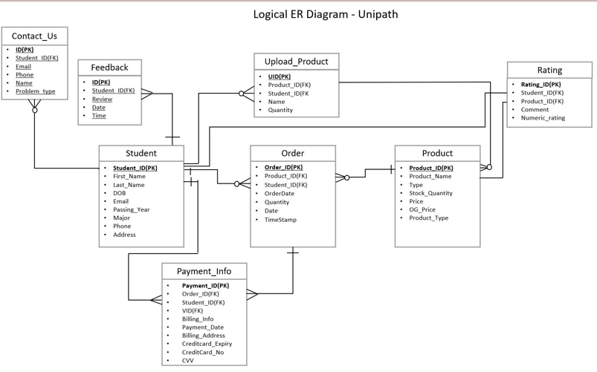
ER Diagrams (Conceptual, Logical) - Sanket
https://docs.google.com/presentation/d/1FSyPd8IBIcwBhUcc3GW5N0RbF3yHxMUu/edit?usp=sharing&ouid=101575546030556260281&rtpof=true&sd=true

Slide 11
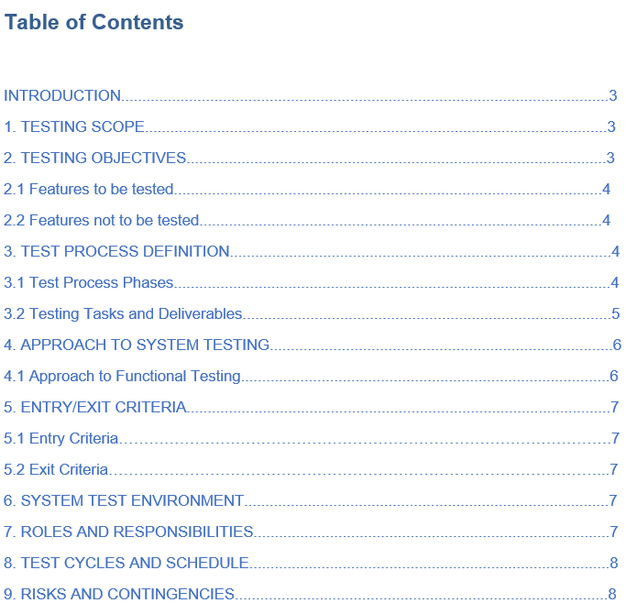
Test Plan - Along
https://docs.google.com/document/d/1S1ZP7h8Yrh0RF9vUse4LOV78Wk0dbt7D/edit?usp=sharing&ouid=101575546030556260281&rtpof=true&sd=true

Slide 12
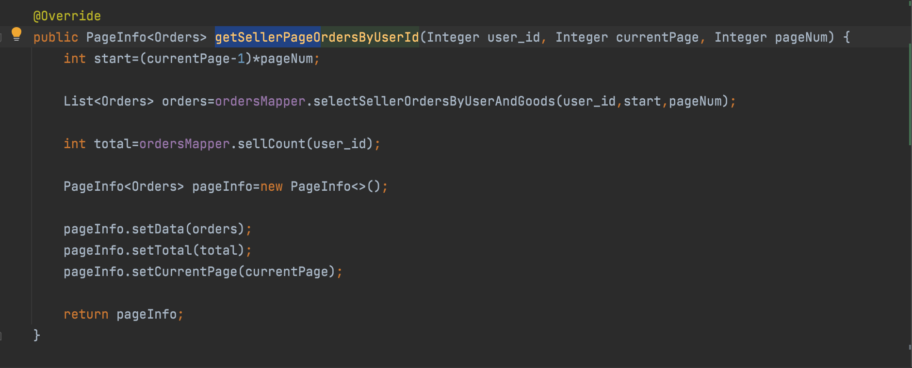
Source Code - Xinhao

Slide 13
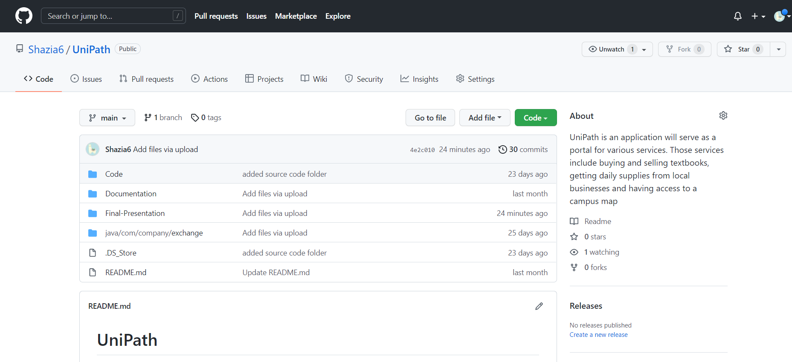
Github- Xinhao

Slide 14
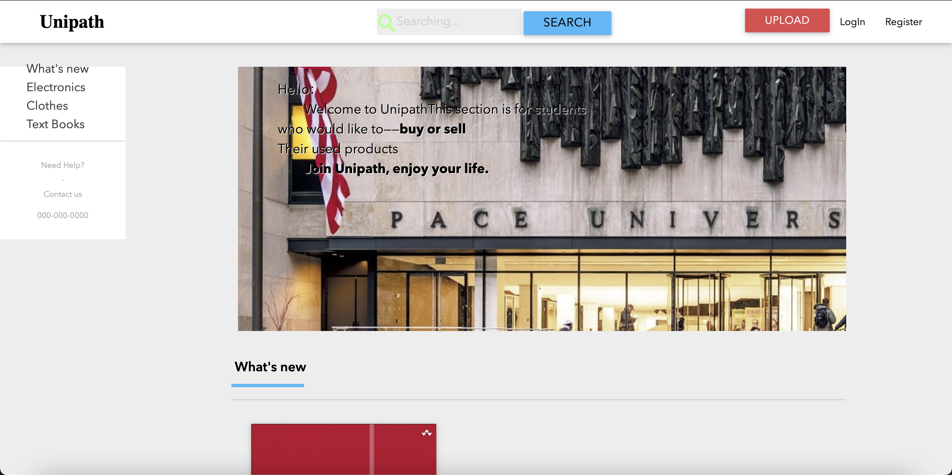
Demo - Xinhao

